Slide 1
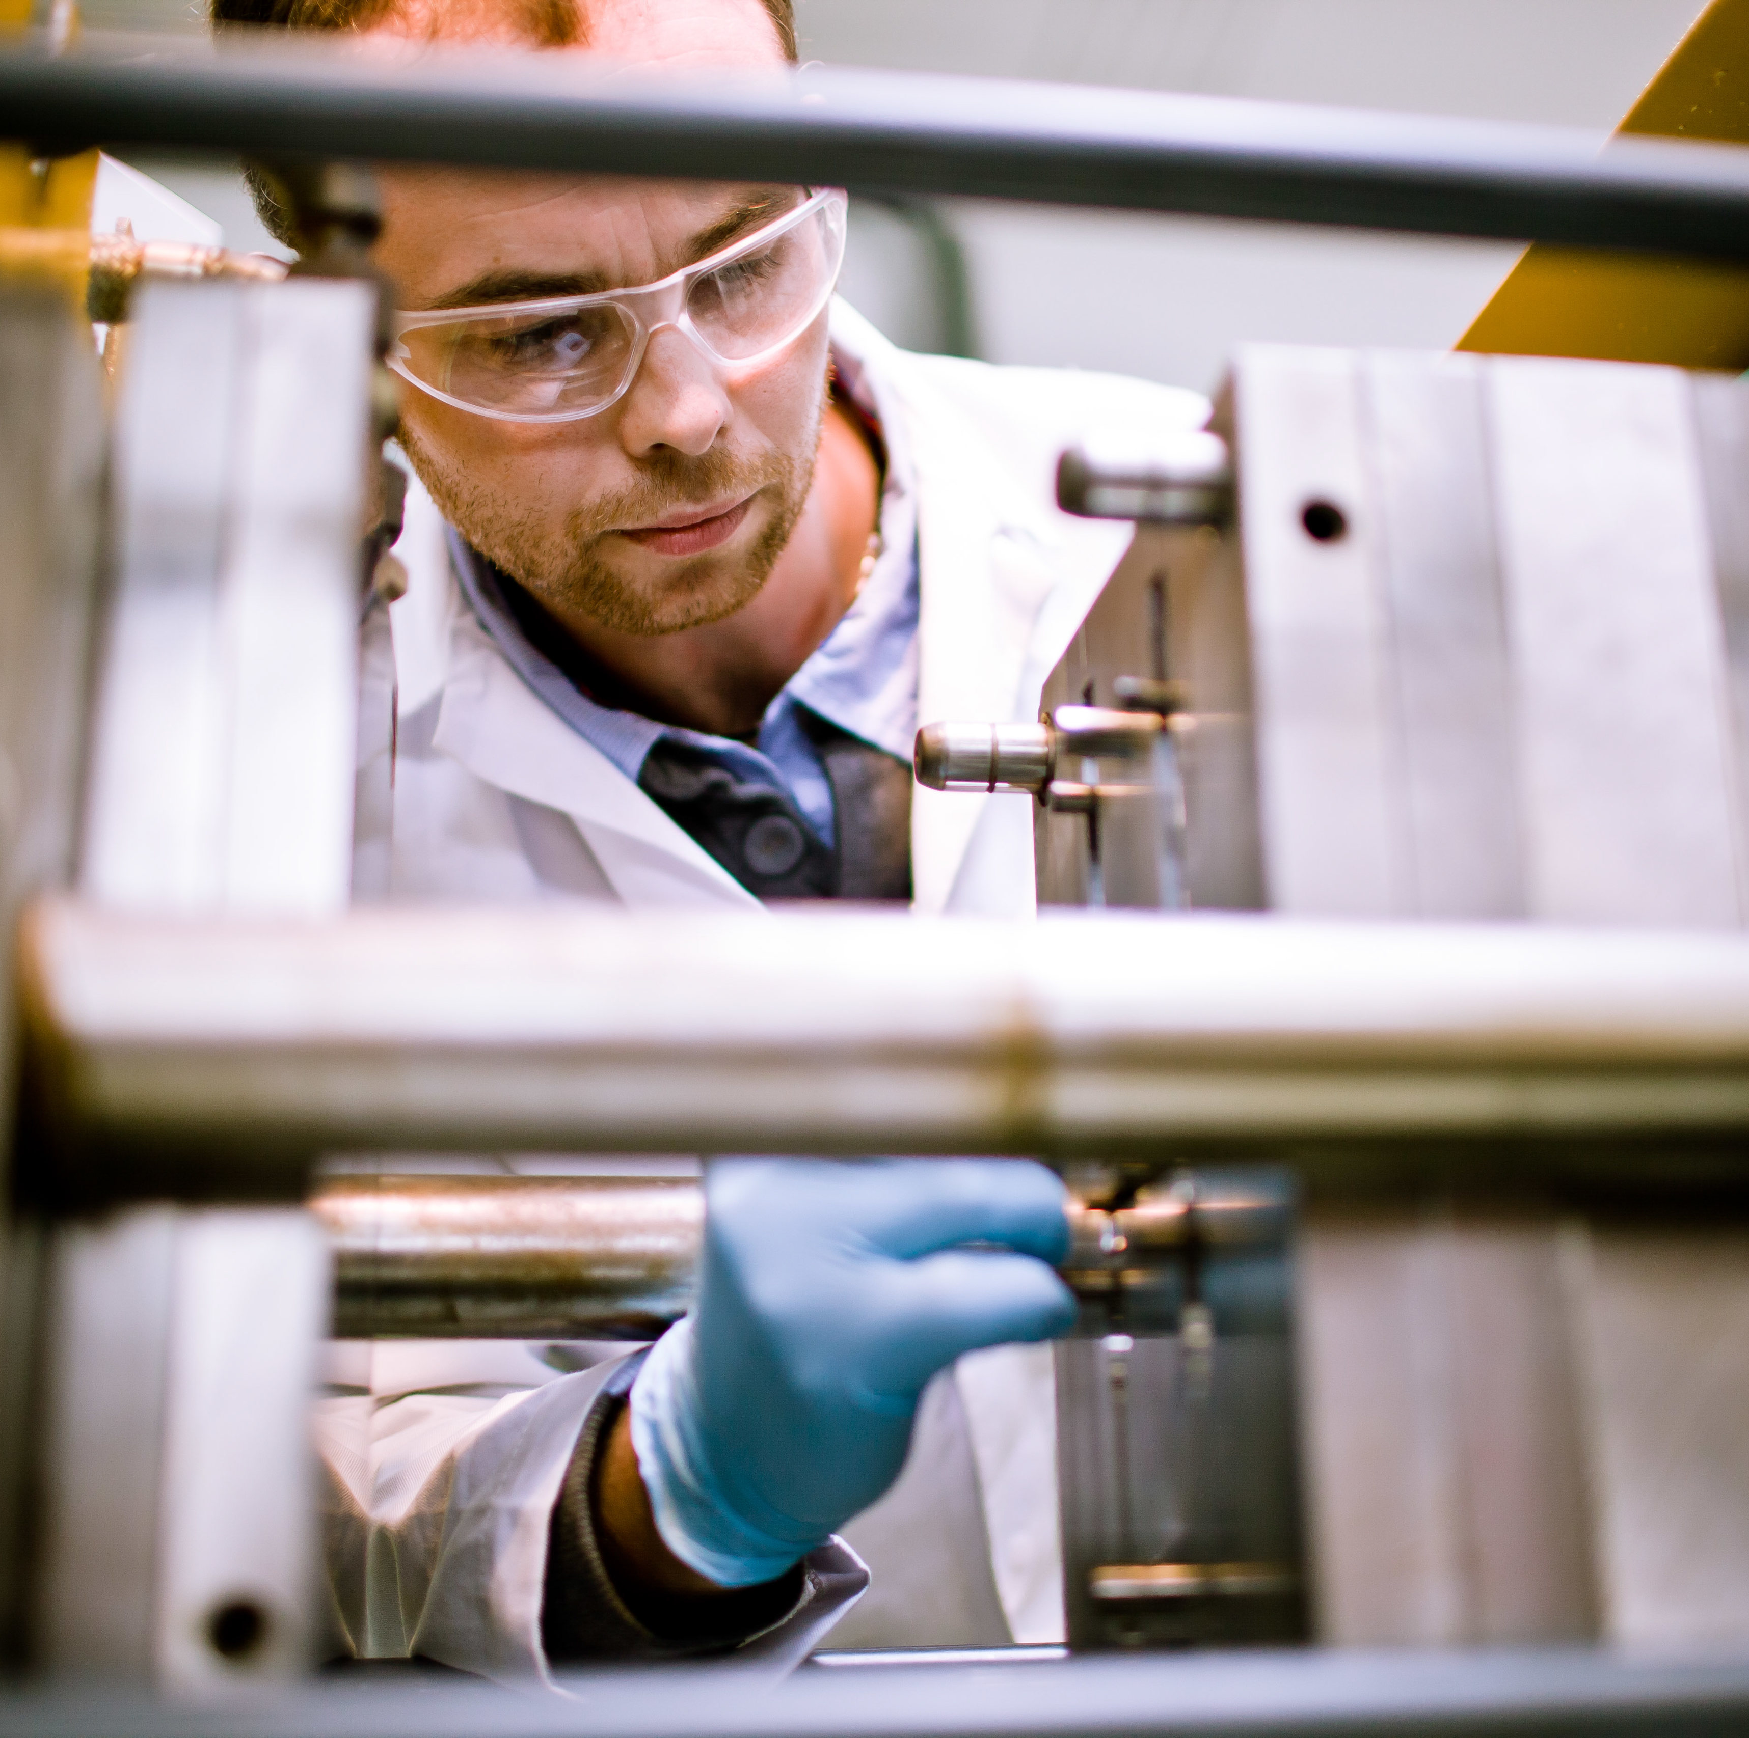

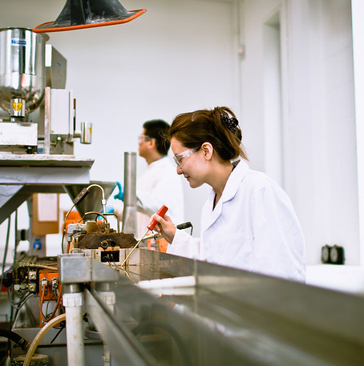
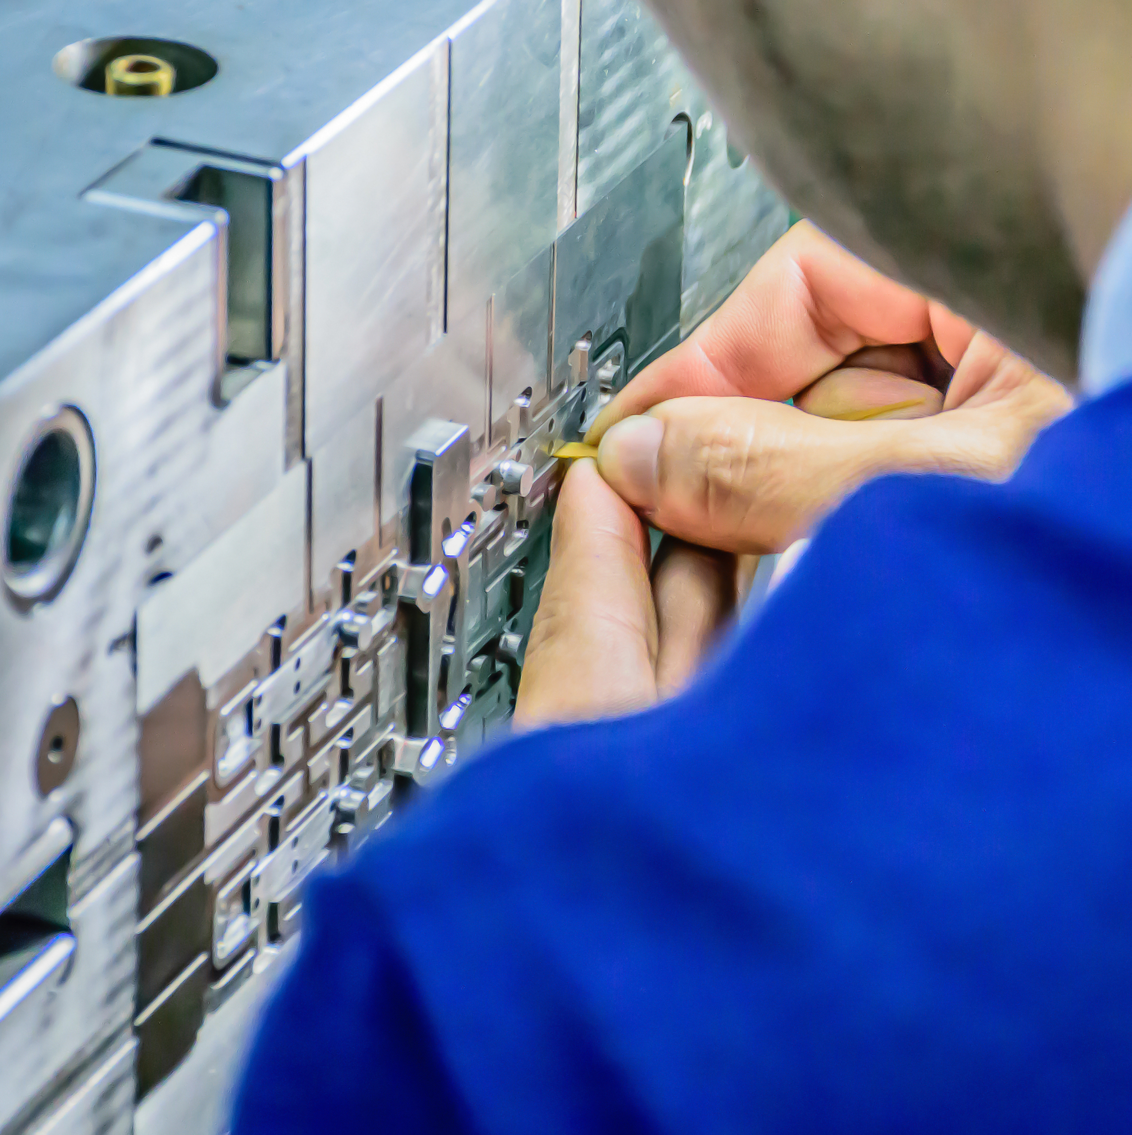
Get a Degree by Apprenticeship
ADD YOUR COMPANY
LOGO HERE
Bachelor of Science in
Polymer Processing
Technology
Level 7, 3yrs
Contracts start May 2021, 15 week academic portion
start Sept 2021
All interested employees should forward their CV to xxxxxxxx -- Closing date for submission xxxxx/2021
If you require more information, contact xxxx in HR or e-mail to xxxxxx
Entry Requirements: Leaving Certificate (or equivalent), Grade 06 at ordinary level in 5 subjects 2 of which must be maths and a language (English or Irish). This criteria does not apply to over 23’s but all applicants will follow company and SOLAS recruitment procedures.

